Slide 1

Parents’ Information
Evening FOR
Year 1 & 2
Learning Together In God’s Love.
Wednesday September 7th 2022
Welcome and Good Evening!

Slide 2


Opening Prayers
In the name of the Father…
Lord let your Spirit of mercy and compassion fill this school and community. Help us all to strive to become more like you in all that we say and do each day.
Inspire us as we look to you for guidance with raising and teaching our children. Help each of our children to enjoy their learning and take delight in their faith. Help them to persevere in their studies and give them the desire to learn all things well with the support of staff, parents and teachers.
Bless us all: Parents, Carers and Staff at every level. Let us always endeavour to share our knowledge with gentle patience. Help us to try to always bring the truth of your word to their eager minds. Grant that we: staff, parents and carers alike, may follow Jesus Christ- the way, the truth, and the light.

Slide 3

School leadership & staff Introductions
Mr Pietro Chiesa-Chair Ms Toyin Gbomedo-Vice-Chair
Mrs Moore – Head Teacher
Miss Wade- Deputy Head Teacher & Whole School Curriculum Lead and Phase Leader KS2
Mrs McDonald-Assistant Head Teacher & Whole School Assessment Lead - Phase Leader for KS1 & CT Palm Class
Miss Baptiste – AAHT/SEND & Inclusion, English Lead
Mrs J Hamilton- EYFS Shadow Lead & Viridis Manager
Mrs Antao and Mrs Badaloo- Reception Teachers
Mrs Sohail and Mrs Jasminka– Nursery & Viridis Instructors
Miss Charlemagne, Mrs Romero, Mrs Olalla-Reception TAs
Nursery & Viridis TAs & Welfare: Mrs Hussain, Mrs Hajkowska, Mrs Gene, Mrs Martins, Mrs Mabel & Mrs Samuel

Slide 4

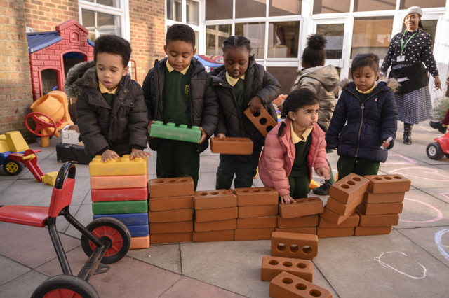
Aims of this meeting
To share the School’s Vision & Mission
Discuss Home School Agreement
Discuss School Expectations
Discuss RHE: TEN TEN
RE Curriculum
Discuss Plans for This Term (News Letter)
To Meet Your Child’s Class Teacher

Slide 5

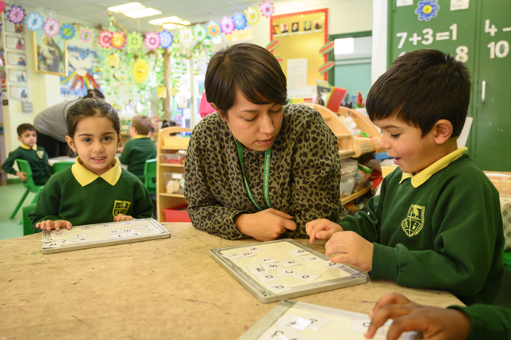
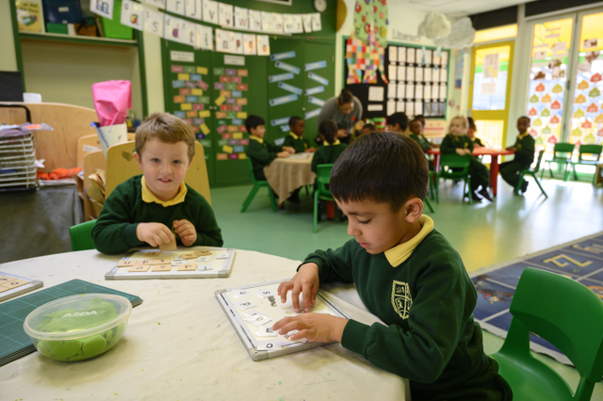
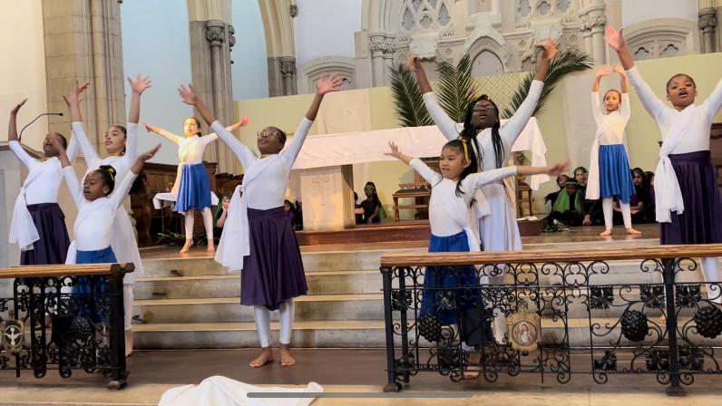
We work in partnership
All
Parents
First
Teachers
Support
Staff
Your
child at
the heart
Teachers
Church
Parish
Community

Slide 6

What is the SCHOOL’s vision
MISSION AND MOTTO?
To have the teachings of Christ and our Christian Morals, Values and Ethos continue to be central to our schools’ practice now and in the future
To ensure our Faith and Ethos are lived and practised by all each day
To ensure parents and carers are aware of the school’s expectations of them captured within our: HOME SCHOOL AGREEMENT
To ensure that we work in partnership to give our children the best education
We are a part of OUR LADY OF GRACE CATHOLIC MAT (OLOG) and work together as one body across all Catholic Schools in Newham
Schools Currently
In The OLOG MAT
St Helen’s, St Joachim’s,
St Edwards, St Francis,
St Antony’s & St Winifred’s

Slide 7
Crucial Operational matters
School starts at 8.45 am promptly for EYFS each morning! 90% of our pupils got in on time this week.
Absences & Lateness are strictly monitored as these are indicators of a range of issues. The School Wants 100% on time
So far Autumn Term started with average 95% …on average in attendance 5% of pupils absent to date
Knowledge of Numbers is very important
Does your child know their Number Names & Values?
Phonics must be practiced daily- children need to practise, practise, practise! Use the YouTube Links
Mark Making, Colouring, Tracing and last Letter Formation for many still needs improvement-practise, practise, practise!
School Improvement Fund Payments Are Requested
of All….It Is Only £30 per family per year!

Slide 8

School Procedures
Holidays in term time are not allowed as the Government and Newham Borough have clearly stipulated ~ Families are expected to take breaks during the normal school holidays.
Correct School Uniform: clothes, shoes, tights, socks, haircuts, must be worn to school daily/ PE kit worn on PE Days. We are clearly stating what is allowed-all are expected to be compliant.
All uniforms should be labelled. Lost uniforms are returned if labelled. Mrs Samuels and staff can be contacted regarding lost property. Lost Water Bottles have been numerous in school
Any Concerns ~ Discuss concerns relating to your child firstly with the class teachers as they have the context and information of the day to day happenings and will be best able to help you.
If needed, the class teachers will direct you to any further support that is needed based on the circumstances

Slide 9
Behaviour Management
  Positive behaviour management is used
  right across the school at St Antony’s.
  All pupils begin each day ‘ON TRACK’
    Praise, points, rewards, certificates are given
    for staying on track through out the day/week
    If a pupil does not behave or follow instructions
    They are given a verbal caution
    If the inappropriate behaviour continues
    their name is moved to CAUTION
    If the wrong behaviour persists the pupil is put on RED ALERT! Resulting in time out
    or the pupil sent to an SLT member (Head/SLT)
    For serious infringements or for habitual repeated
    rule breaking parents are called in.

Slide 10


EYFS Parents do you support your child’s learning at home
Each Day? Read to you child daily?
“Parents who actively support their children’s learning will improve their attainment by 25 to 50% “-Professor Charles Deforges

Slide 11
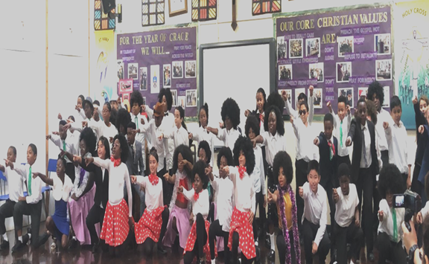
SEPTEMBER 15th Is World Afro Day! St Antony’s Will Celebrate to elevate & equate not negate

Slide 12

NOW YOU WILL MEET WITH the TEAChERS… thanks for attending tonight’s meeting.

Slide 13
St. Antony’s catholic primary has Christ central to all we do
Our Children, Staff And Parents Are Asked To Model Christ’s Behaviour, Thinking And Action Daily.
Learning Together In God’s Love

