Slide 1
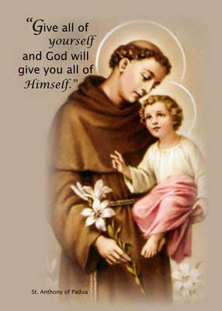
ST Antony’s Catholic Primary A Brief History For Our 160th Anniversary
Prayer of St Antony:
Dear Lord, let me love you so much each day, that I have no room for anything else but your love and compassion for others.
Let me serve you so faithfully each day that I will never count the cost of serving each of your precious creations: man, woman or child.
Help me to see you in all the beauty that you surround me with daily, knowing that you are always close to me, through the birds and the bees, the flowers and the trees, the rain and the sun since time itself had begun. Amen.

Slide 2
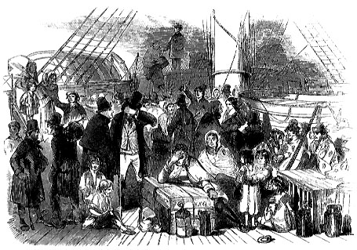
Ursuline Nuns From Belgium First Catholic Schools In Forest Gate
The first traceable Catholic school in the area known as the old West Ham Ward which covered a wide ranging area of what later came to be called Forest Gate was established in Stratford around 1815. Later in the mid-nineteenth century the population in Forest Gate was increasing, largely due to an influx of Irish economic refugees, fleeing the potato famine in their homeland.
Then Father James McQuoin , a Catholic Priest based in Stratford was seeking help with his mission to educate Catholic children, in response to the push by the Church of England and other Non-Conformist organisations that were providing education through establishing local charity schools.
In February 1862, Father James McQuoin invited a party of four Ursuline nuns from Belgium to visit the Upton Park area (which was the more developed part of Forest Gate, at the time). He had invited the Ursuline Nuns as their order was one largely committed to education and he was aware that they had been seeking a base in England for at least a decade prior from around 1852 with no success.
Irish immigrants arriving in the Docklands in the 1850s

Slide 3
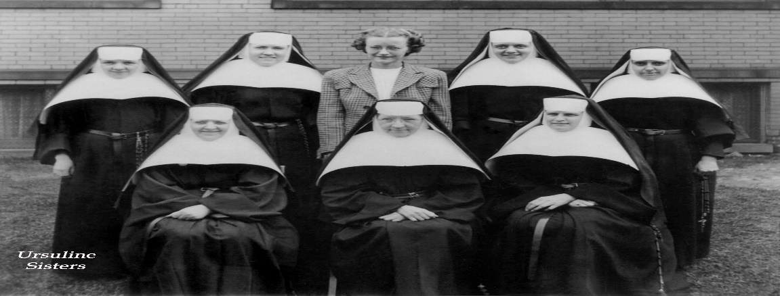
Ursuline Nuns From Belgium First Established St Antony’s On ‘Sun Row’ Now Known As Green Street
Their intent was to found schools in the East of England. They had tried to establish schools elsewhere across the east previously, inclusive of within Walthamstow while also seeking to establish bases for themselves in London - but to no avail.
When the Ursuline order had originally come to London in 1851 they encountered such hostility that some returned home to Belgium. Then eleven years later they were invited back by this local priest Father James McQuoin to start schools. The sisters received much support this time around especially from a Cardinal Nicholas Wiseman.

Slide 4
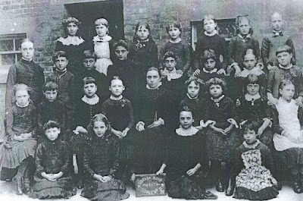
St Antony’s and St Angela’s Share A Common History
Ultimately, in 1862 four Ursuline nuns arrived in Upton Lane from Belgium and as their order required, they immediately began to establish schools for girls of both primary and secondary age. They initially founded St Antony’s Catholic Primary on Sun Row (now known
as Green Street in Upton Park) on the 28th May 1862.
Reverend Mother Agatha and Mother Victoire began to teach the children who were the first pupils of St Antony’s in two cottages in Sun Row (Green Street). The following year the nuns had the stables in the convent on Upton Lane converted into a school – this was a big improvement on Sun Row - and so they moved the teaching there.
Following further visits to Forest Gate over many years, the Ursuline Nuns acquired a semi-detached house with a large garden in Upton Lane. They bought the adjoining house the following year which became known as ‘The Old House’ which was and grew to become St Angela’s Secondary School and together became part of the Ursulines’ founding of St Angela's.
St Angela’s Secondary School then began providing education for young Roman Catholics in the area as a boarding school but later they also established a day school for girls. The major push of the Catholic schools was towards providing formal schooling targeting the middle and poor working class children.
A typical picture of pupils in attendance at schools such as St Angela’s and St Antony’s in Forest Gate between 1862 and 1885
further developed

Slide 5
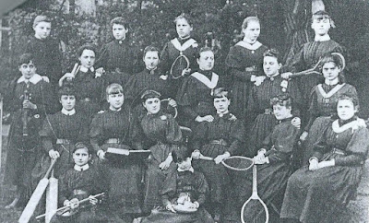
Ursuline Nuns From Belgium Established St Antony’s and St Angela’s In Forest Gate
From the day that Ursuline nuns arrived in Upton Lane from Belgium, and as their order required, they began the education of young Roman Catholics in the area, and operated a boarding school. Although various charity schools were established in England before the nineteenth century, the major push towards providing formal schooling, particularly for middle and working class children, came with the development other, competing non-Catholic, institutions in the nineteenth century in the area.
Other schools, such as independent schools, "Dame schools" and the famous Earlham Grove Music Academy also prospered in Forest Gate in the latter years of the nineteenth century. The education of children in Upton Lane and Forest Gate owes their development to these early local educators.
Boarders at St Angela’s, sister school to St Antony’s Catholic Primary pose with their PE equipment of tennis racquets and cricket bats-PE kits were very different to what we wear in school today!

Slide 6
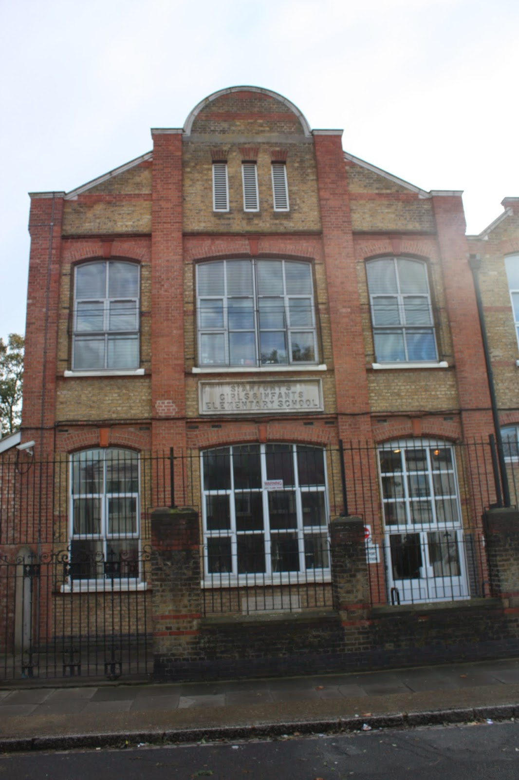
St Antony’s Was Once Relocated To Where St Bonaventure’s 6th Form Is Now Then to its current location on Upton Avenue
This Old Victorian Building which still stands on Lancaster Road, behind St Antony of Padua Catholic Church became the next location for St Antony’s Catholic Primary after the young but flourishing school was moved from Sun Row (Green Street).
Today this building forms part of St Bonaventure’s Secondary School’s 6th Form College.
It was just around the mid 1950’s-60s that St Antony’s moved to its current location on Upton Avenue in Newham.
Throughout the 1950-1960s St Antony’s Catholic School first existed as two separate schools: St Antony’s Nursery School (serving children from Nursery to year 2) and St Antony’s Catholic Junior School. In 1999 the two schools merged into one school- St. Antony’s Catholic Primary School. The ‘junior’ bit is still retained today as part of the school’s e-mail address: info@st-antonys-jun.newham.sch.uk
This is St Antony’s Catholic Primary School as it stands located today on Upton Avenue in Newham.
Old Victorian St Antony’s School Building on Lancaster Road E7 9PX

